Slide 1
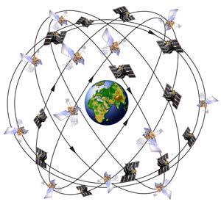
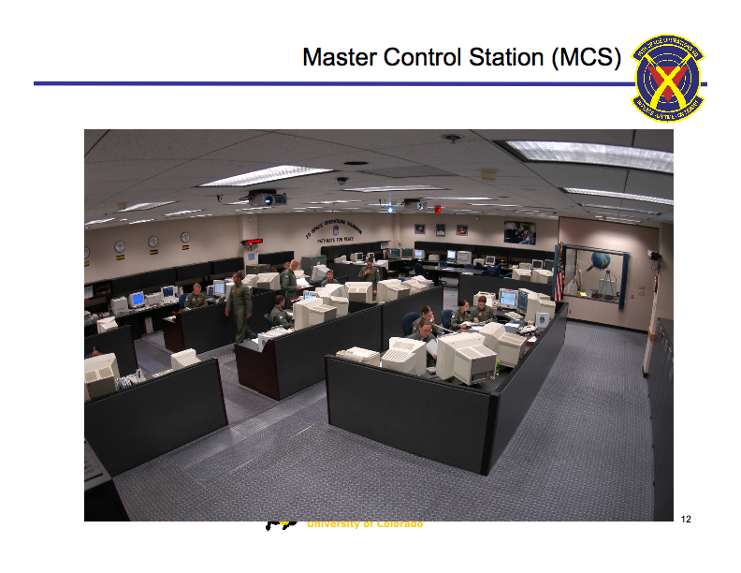
Satellite Constellation & Control Segment
ASEN 5090
ASEN 5090 LECTURE NOTES – LARSON, AXELRAD

Slide 2
OUTLINE
CONSTELLATION
Requirements, orbits, satellites
Almanac description
CONTROL SEGMENT
Role, configuration
GPS Time
Satellite status

Slide 3
Designing a Constellation for Satellite Navigation
Requirements
Constraints
24 hours a day
global
real-time
cheap for users
light weight
passive
all weather
minimize atmosphere delay and attenuation
$$$$
# satellites
inclination, planes
altitude
ground tracks
frequencies allocated
power
encryption
dual-use (Civilian & Military)
ground support needs

Slide 4
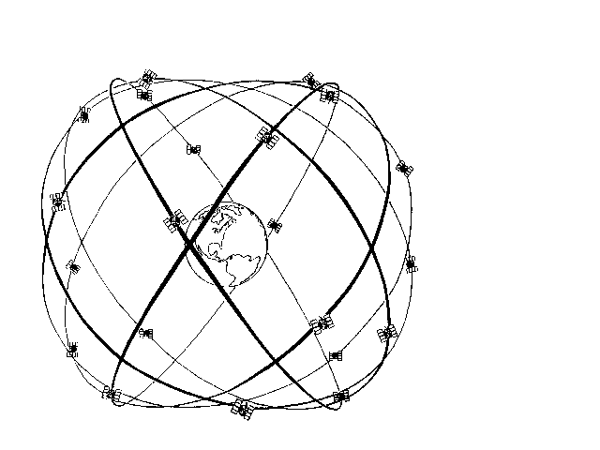
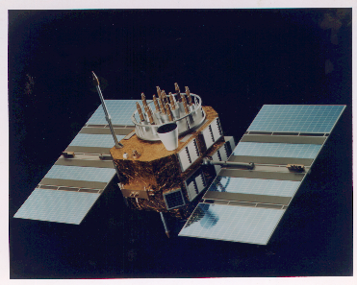
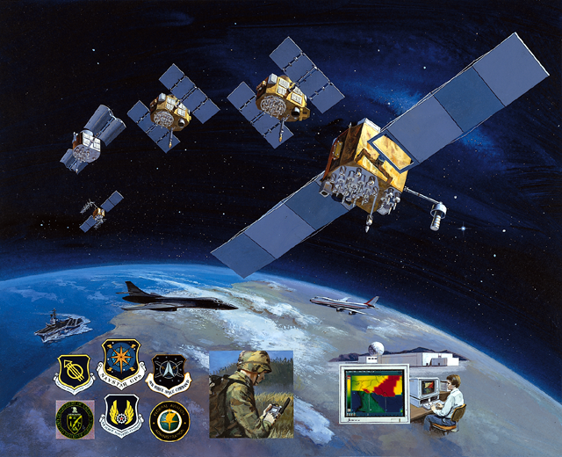
GPS Space Segment
Block II/IIA
Block IIF
24-satellite (nominal) constellation, (31 Actual)
Six orbital planes inclined at 55 deg, four satellites per plane
Not geosynchronous.
Semi-synchronous, nearly circular orbits (20,200 km altitude)
Redundant cesium and/or rubidium atomic clocks onboard each satellite
Antenna array pointed at the earth
Notes:
8
11
Your fathers GPS

Slide 5
CONSTELLATION STATUS FROM USNO
ftp://tycho.usno.navy.mil/pub/gps/gpsb2.txt
I’m fond of http://en.wikipedia.org/wiki/List_of_GPS_satellites
GPS OPERATIONAL SATELLITES (BLOCK II/IIA/IIR/IIR-M/IIF)
BLOCK II, SVN 13 – 21, Rockwell Int., Launched 1989-1990
BLOCK IIA, SVN 22 - 40, Rockwell Int. 180 day autonomy, Launched 1990-1997, two Cs and two Rb Clocks; SA & A-S. The Block II/IIA satellites were launched from Cape Canaveral Air Force Station, Florida, aboard the Delta II medium launch vehicle (MLV).
BLOCK IIR, SVN 41 - 61, Lockheed Martin, 180 day autonomy with autonav, three Rb, SA and A-S. 1997-2009
BLOCK IIR-M satellites transmit a second civil signal L2C on the L2 frequency and the military M signal on the L1 and L2 frequencies. SVN 49 also transmited a prototype L5 signal but was never set “usable”.
BLOCK IIF
Satellites add third civil frequency L5 with a 10.23 MHz code. SVN 62, 63, 65,66 – one launched every year from 2010 to 2013.

Slide 6
GPS STATUS – FROM NAVCEN
GPS OPERATIONAL ADVISORY 240
SUBJ: GPS STATUS 28 AUG 2011
1. SATELLITES, PLANES, AND CLOCKS (CS=CESIUM RB=RUBIDIUM):
A. BLOCK I : NONE
B. BLOCK II: PRNS 1, 2, 3, 4, 5, 6, 7, 8, 9, 10, 11, 12, 13, 14
PLANE : SLOT D6, D1, C2, D4, E3, C6, A4, A3, A1, E6, D2, B4, F3, F1
CLOCK : CS, RB, CS, RB, RB, RB, RB, CS, CS, CS, RB, RB, RB, RB
BLOCK II: PRNS 15, 16, 17, 18, 19, 20, 21, 22, 23, 24, 25, 26, 28, 29
PLANE : SLOT F2, B1, C4, E4, C3, E1, D3, E2, F4, D5, B2, F5, B3, C1
CLOCK : RB, RB, RB, RB, RB, RB, RB, RB, RB, CS, RB, RB, RB, RB
BLOCK II: PRNS 30, 31, 32
PLANE : SLOT B5, A2, E5
CLOCK : RB, RB, RB
FCSTDV, or Forecast Delta-V
FCSTMX, or Forecast Maintenance
FCSTEXTD, or Forecast Extension
FCSTSUMM, summary after event is complete

Slide 7
GPS STATUS – FROM NAVCEN (continued)
2. CURRENT ADVISORIES AND FORECASTS :
A. FORECASTS: FOR SEVEN DAYS AFTER EVENT CONCLUDES.
NANU MSG DATE/TIME PRN TYPE SUMMARY (JDAY/ZULU TIME START - STOP)
2011063 182214Z Aug 2011 06 FCSTDV 235/0345-235/1545
2011064 182216Z Aug 2011 08 FCSTDV 238/0800-238/2000
2011065 231152Z Aug 2011 06 FCSTSUMM 235/0406-235/1143
2011066 251731Z Aug 2011 02 FCSTDV 242/2210-243/1010
2011067 251736Z Aug 2011 13 FCSTDV 245/0820-245/2020
2011068 261520Z Aug 2011 08 FCSTSUMM 238/0817-238/1420
2011069 261747Z Aug 2011 13 FCSTRESCD 244/1415-245/0215
B. ADVISORIES:
NANU MSG DATE/TIME PRN TYPE SUMMARY (JDAY/ZULU TIME START - STOP)
2011070 261817Z Aug 2011 30 UNUSUFN 238/1816-/
C. GENERAL:
NANU MSG DATE/TIME PRN TYPE SUMMARY (JDAY/ZULU TIME START - STOP)
2011047 160718Z Jul 2011 01 LAUNCH /-/
2011055 031855Z Aug 2011 GENERAL /-/
2011061 151959Z Aug 2011 GENERAL /-/
2011062 162109Z Aug 2011 GENERAL /-/
http://www.navcen.uscg.gov/?pageName=NANUabbr

Slide 8
Constellation Status
CGSIC – Civil GPS Service Interface Committee
Hosts meetings at least once per year to update community.
Presentations are posted:
http://www.navcen.uscg.gov/?pageName=cgsicMeetings
See also the Positioning, Navigation, and Timing Committee (PNT)
http://www.gps.gov/governance/advisory/

Slide 9
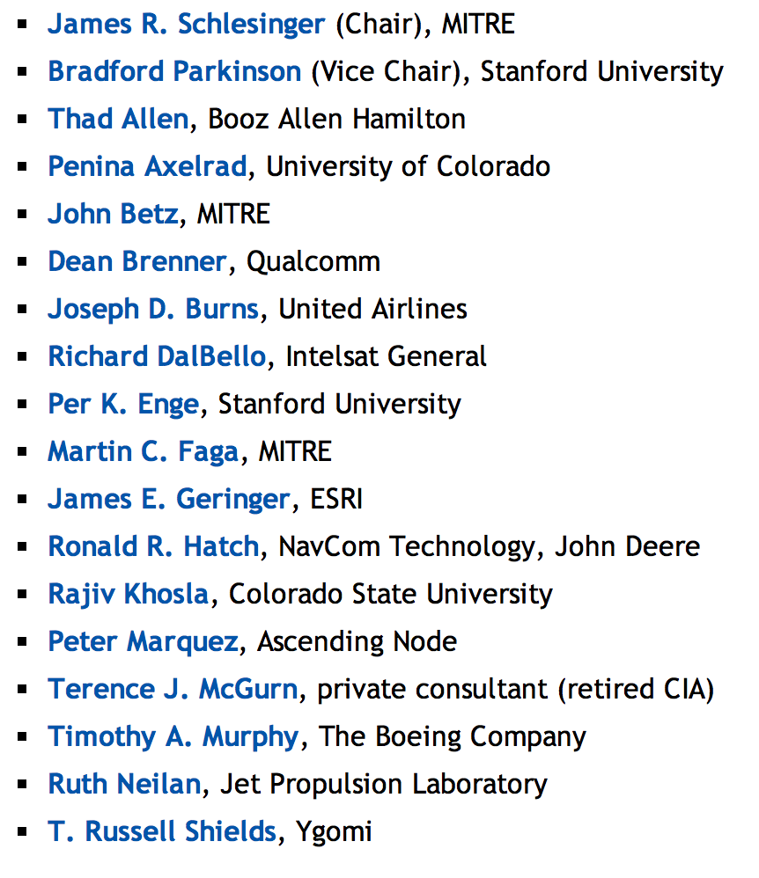

Slide 10
From J. Grant , CGSIC Meeting 9/20/11
http://www.navcen.uscg.gov/pdf/cgsicMeetings/51/27_Grant_CGSIC_GPS_Status%209_Sep11%20_%20v4.pdf

Slide 11
From J. Grant , CGSIC Meeting 9/20/11
http://www.navcen.uscg.gov/pdf/cgsicMeetings/51/27_Grant_CGSIC_GPS_Status%209_Sep11%20_%20v4.pdf

Slide 12
Role of the Control Segment
Observe and record GPS ranging data from monitor stations
Monitor Satellite Orbits & Satellite Health – Integrity
Maintain GPS Time
Predict satellite orbit and clock
GPS almanac (1 km) used to determine which satellites should be visible - it is NOT for positioning
GPS broadcast ephemeris (1 meter) is for low-accuracy, real-time positioning.
Create and upload navigation message data at least once per day
Command satellite maneuvers, payload, and bus maintanance

Slide 13
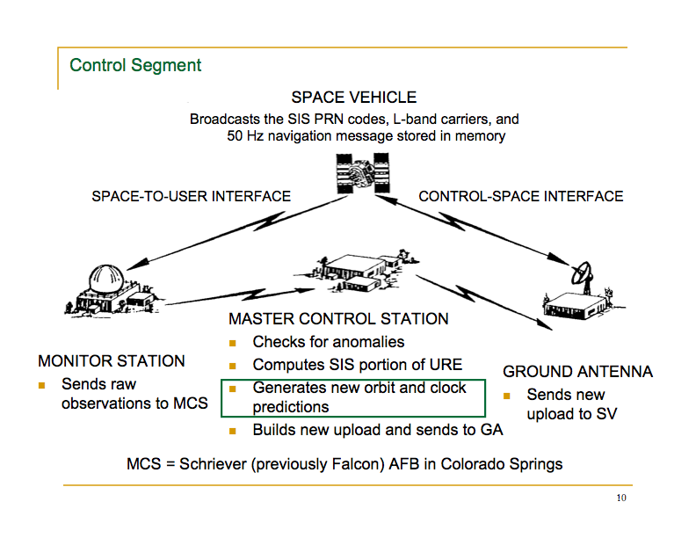

Slide 14
From J. Grant , CGSIC Meeting 9/20/11
http://www.navcen.uscg.gov/pdf/cgsicMeetings/51/27_Grant_CGSIC_GPS_Status%209_Sep11%20_%20v4.pdf

Slide 15
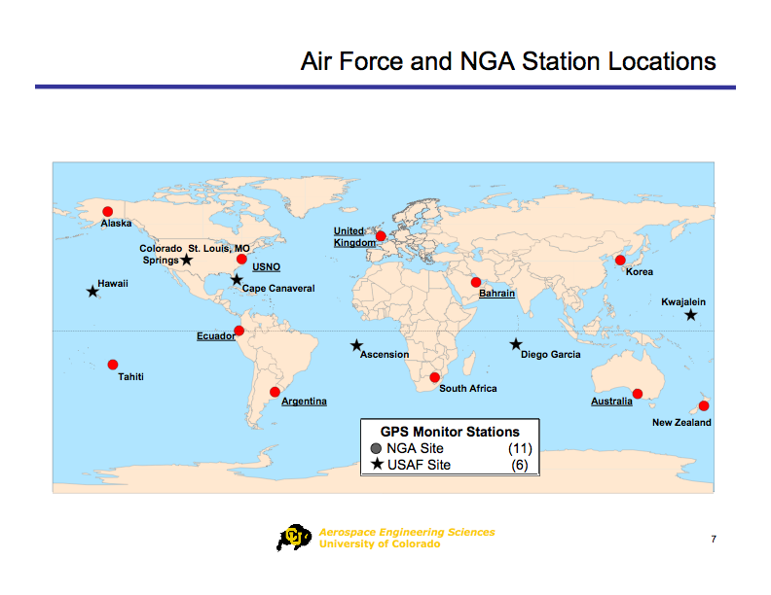

Slide 17
GPS Time
GPS time is maintained by a set of atomic clocks at the MCS and onboard the satellites
Steered to within 1 microsec of UTC(USNO) mod 1 sec – MCS estimates offset, drift, and drift rate of satellite clocks relative to GPS and uploads correction parameters which are sent out via the nav message
GPS time is defined by a week number and seconds of the week (often called time of week or TOW
Standard epoch is midnight on Saturday, 5 January, 1980
Week rollover occurred at midnight, 21 August, 1999 due to limit of 1024 for GPS week in nav message

Slide 18

GPS Space Status – 03 Aug 2009
From 2009 CGSIC Briefing
Nav/Bus /Clock/Reaction Wheel Performance Status
KEY
SV (PRN)
Clock*
Wheel
00R (00) 00/08
 |  | g
g | g | g | g
* II/IIA = Rb, Rb, Cs, Cs
IIR = Rb, Rb, Rb
Bus/Nav Key
Full Redundancy
Redundancy Lost
Reliability Unknown
Drifting within Plane
Unhealthy
Clock/Wheel Key
Meets Spec
Reduced Capability
Unusable for Ops
Unused
In Use
18

Slide 19
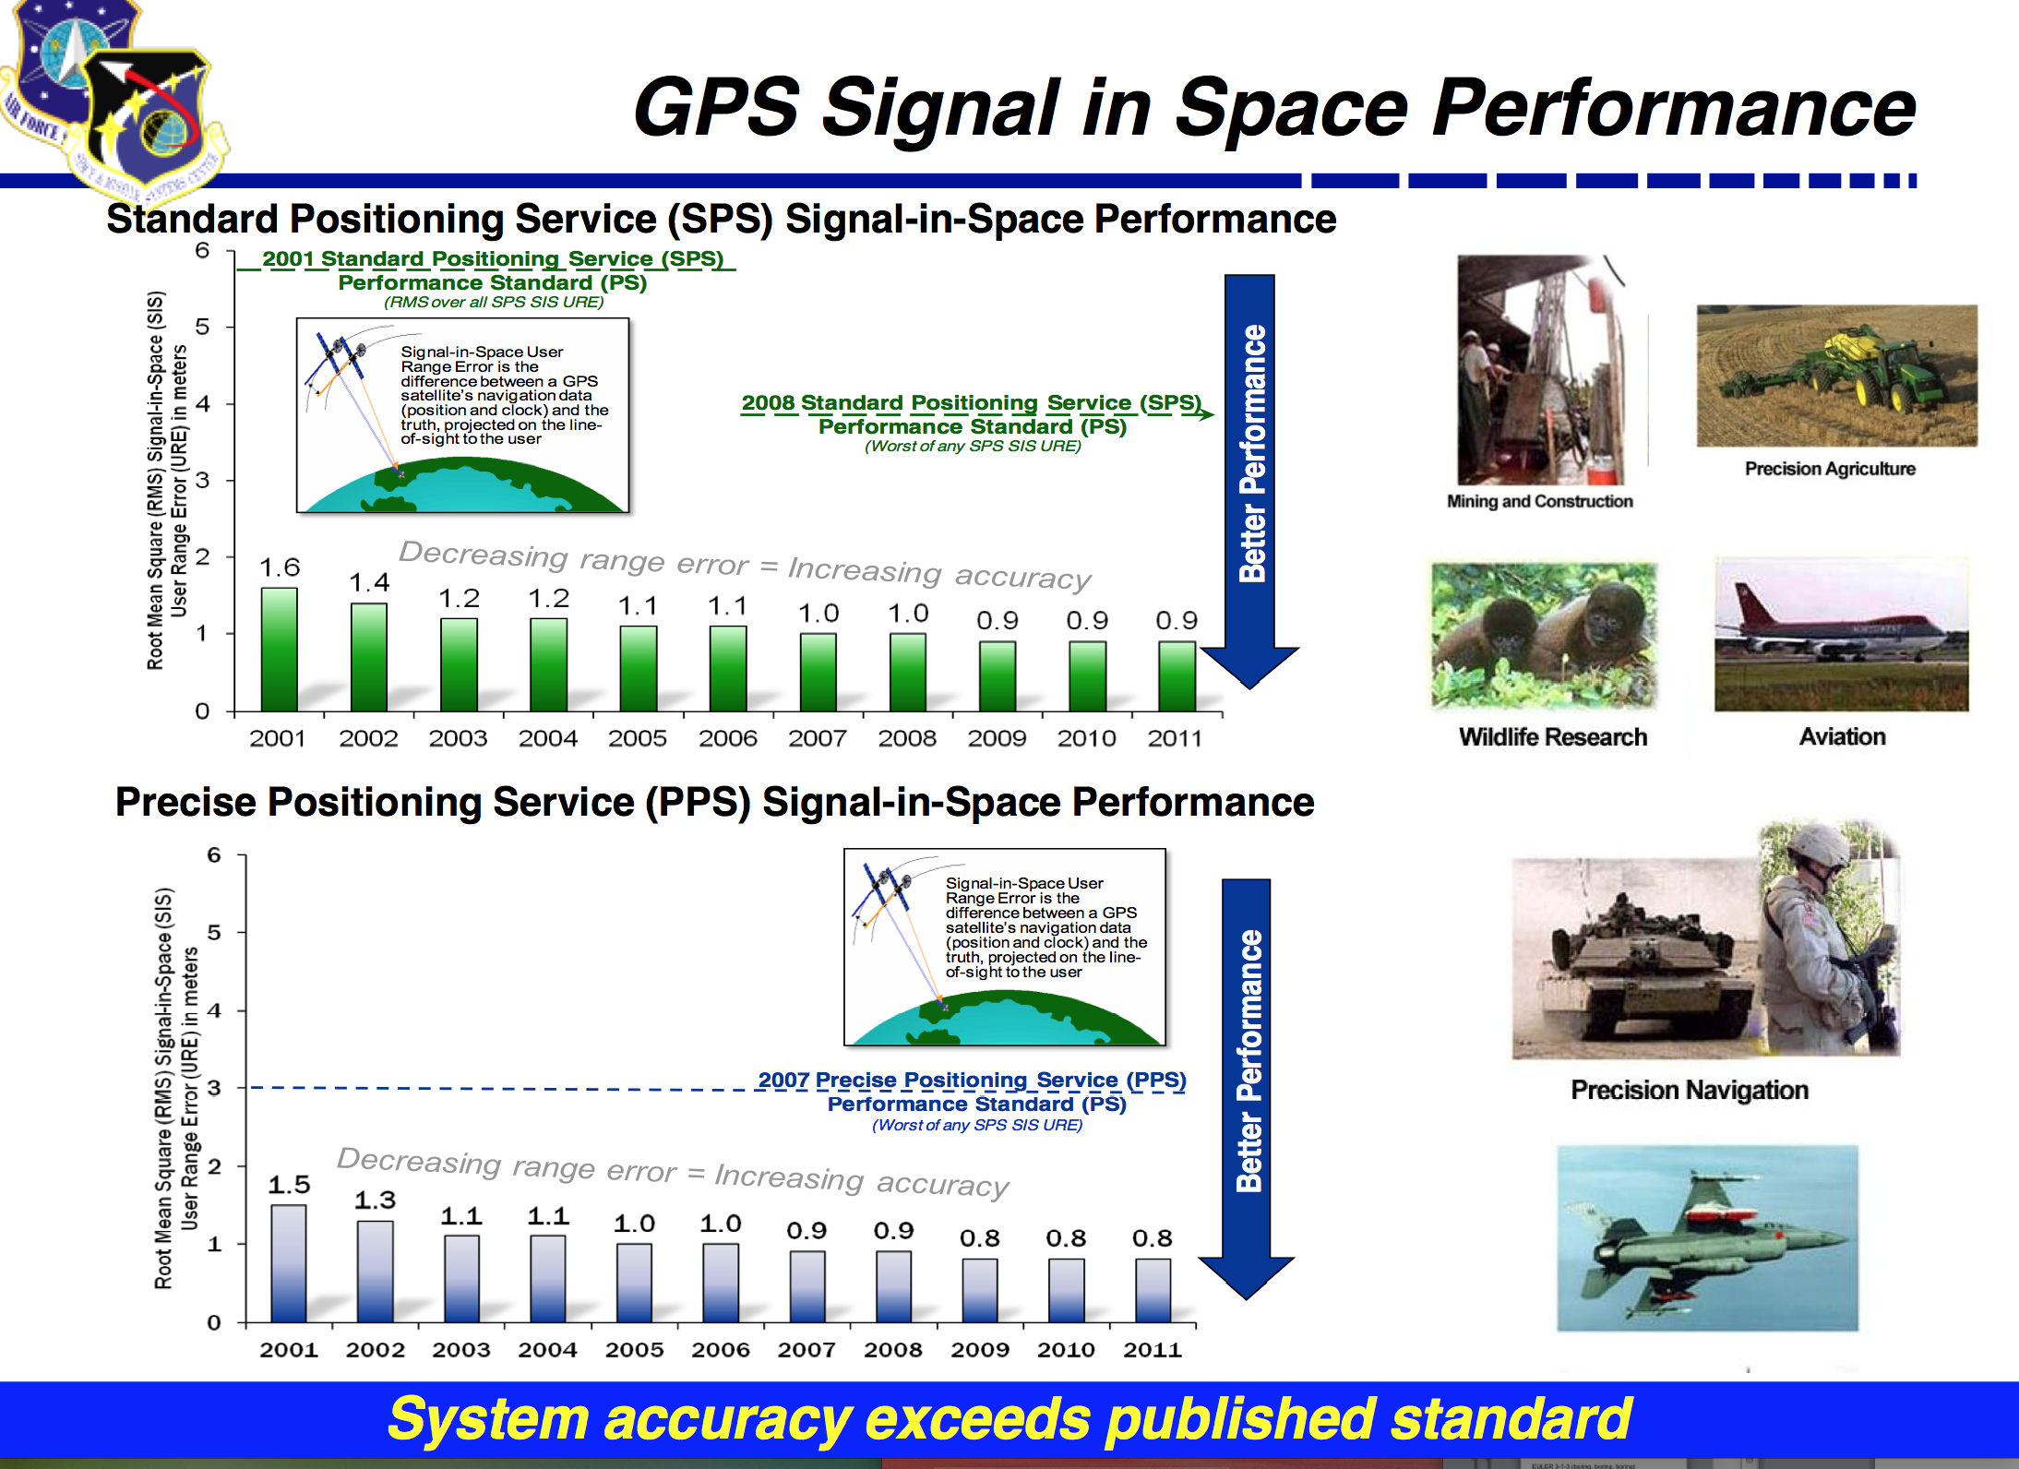

Slide 20
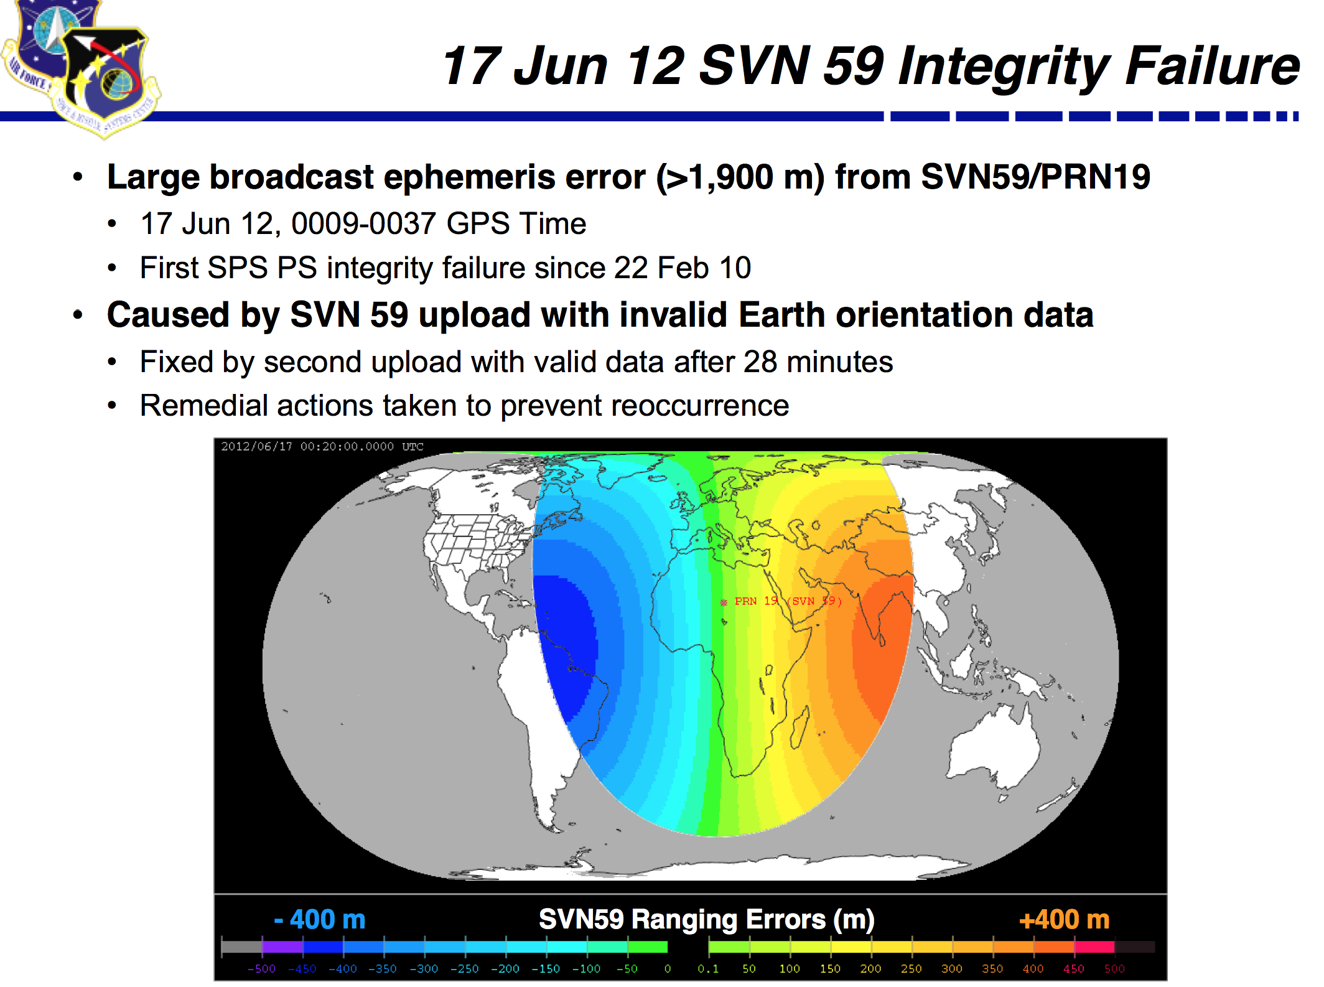

Slide 21
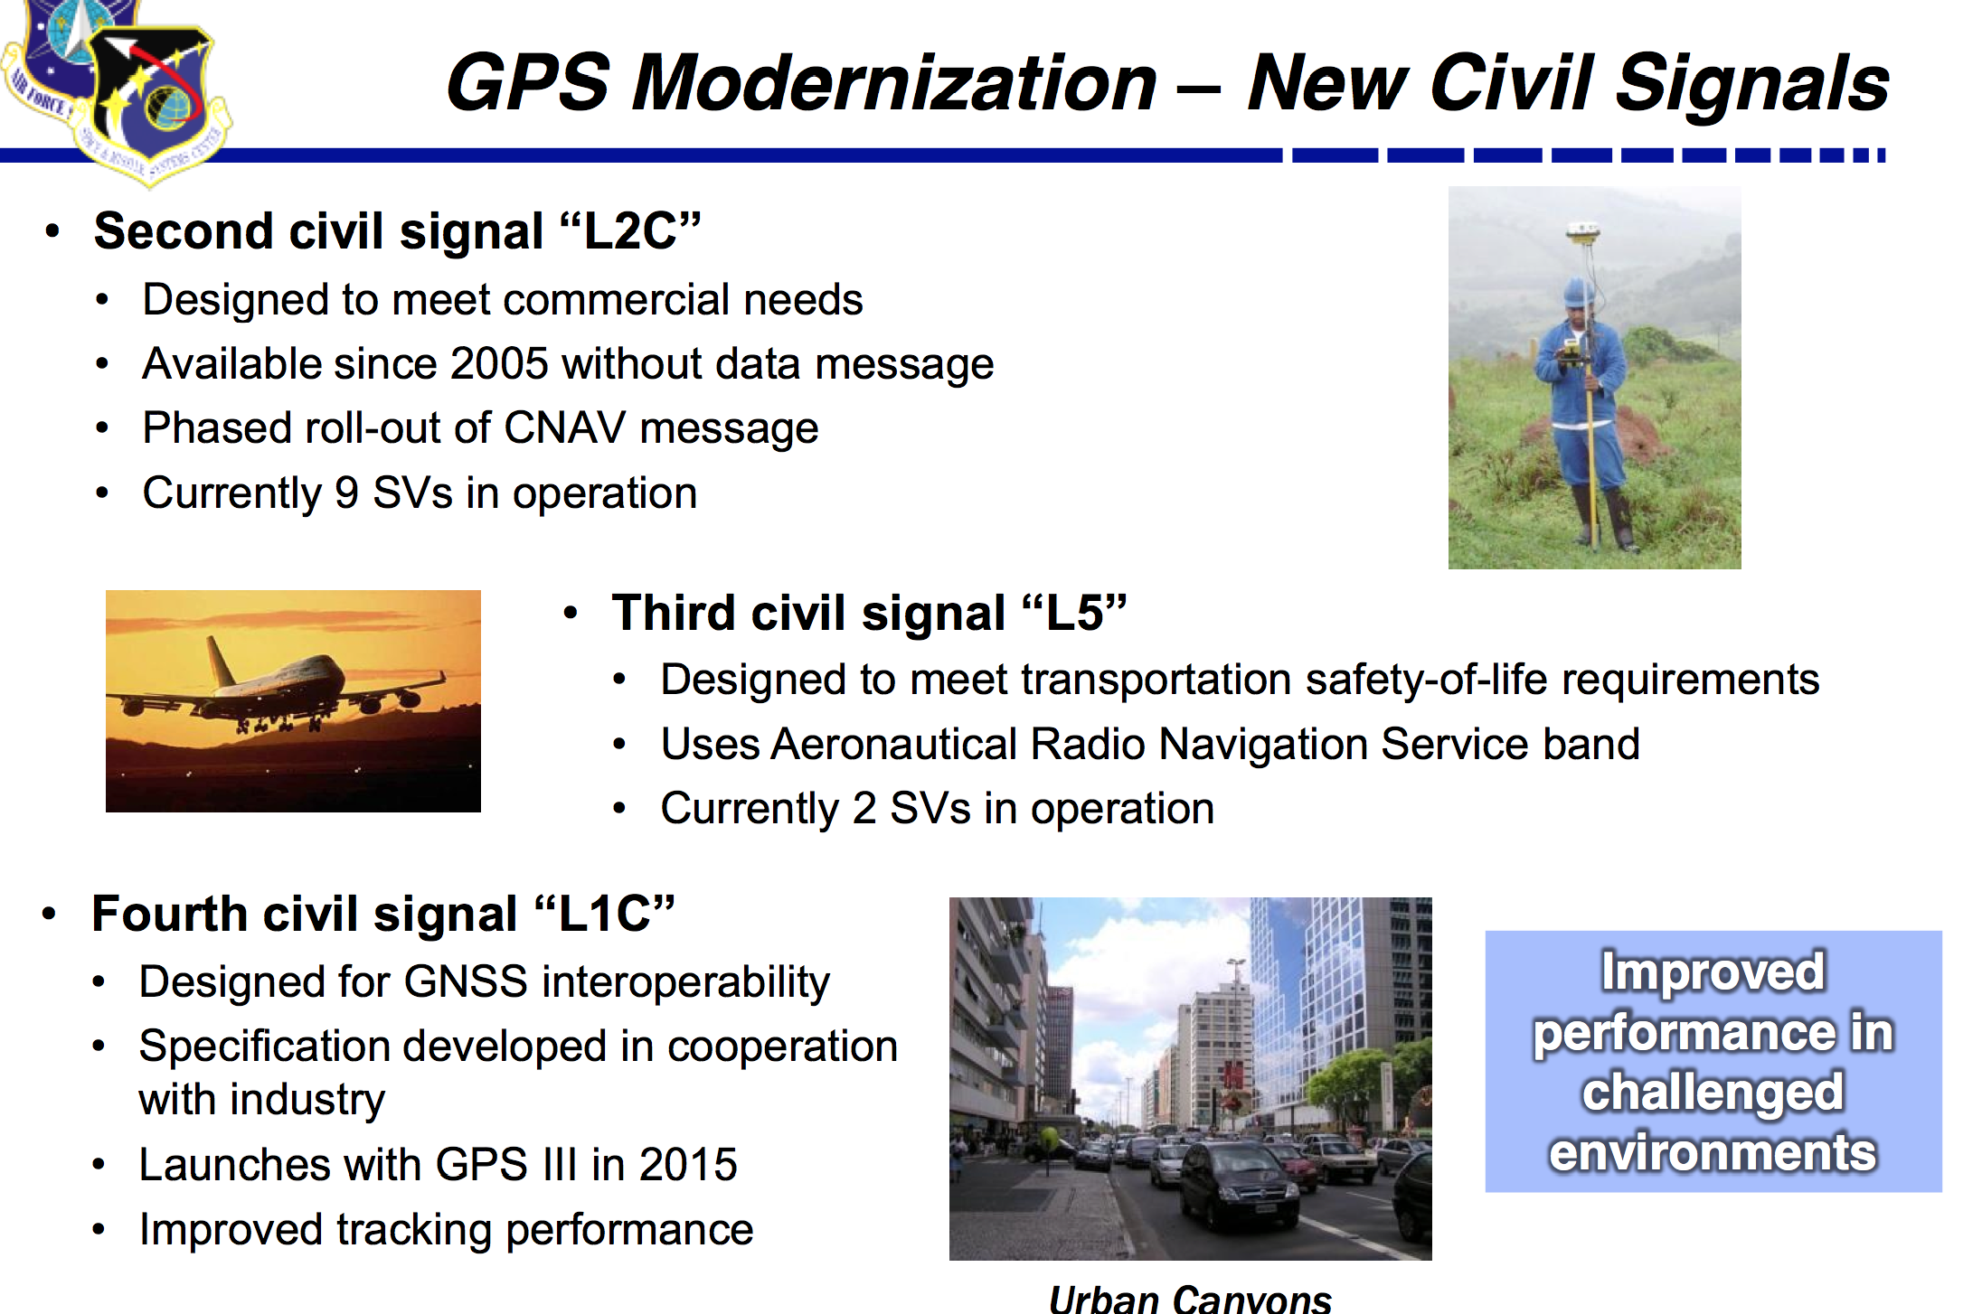

Slide 22
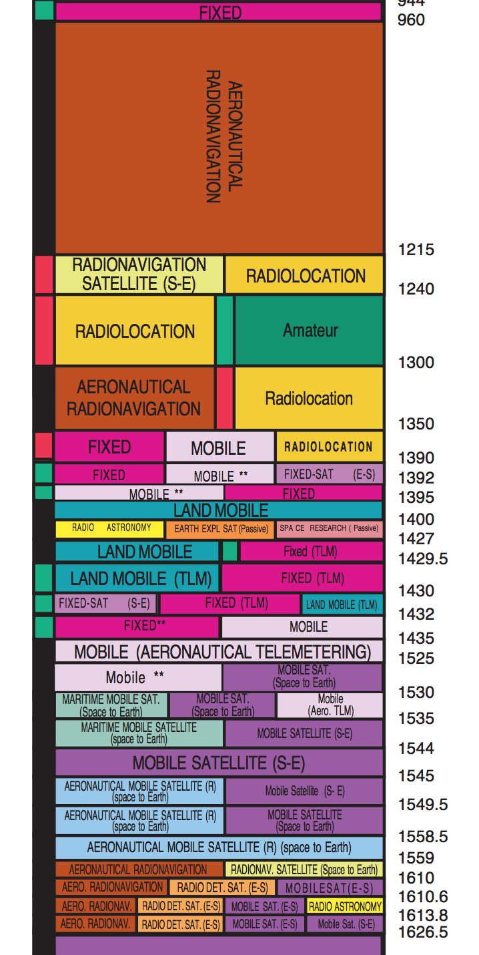
1.22760
1.57542
1.17645

